Slide 1
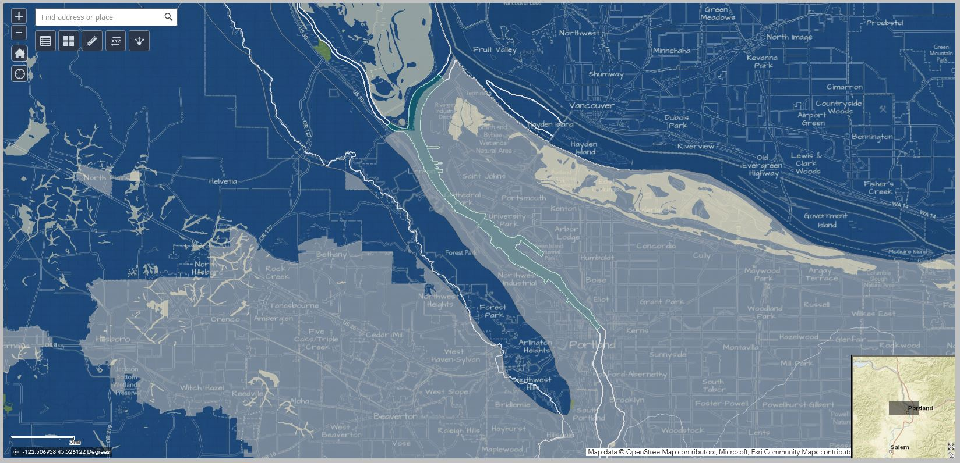
Portland Harbor Mitigation Bank Accounting
Credits and Debits Performance Standards
John Marshall – Retired U.S. Fish and Wildlife Service / Oregon State Office
Oregon and Southwest Washington Mitigation and Conservation Bank Interagency Review Team (IRT) Representative for over 10-years
Volunteer Portland Harbor Superfund Community Advisory Group and Steering Committee
503-913-1695
jl.marshall@comcast.net
https://www.mitigationcreditdebit.com
https://www.mitigationcreditdebit.com/PortHarbMitigationBankAcc2.pptx

Slide 2
Accounting Goals and Objectives
Mitigation bank credit-debit and performance standard data records for the Portland Harbor mitigation banks have often proven difficult to access and interpret. Stakeholders are exploring ideas for improvement.
Accountability
Transparency
Accessibility
Consistency
Verifiability
Independent Tracking
Independent Testing

Slide 3
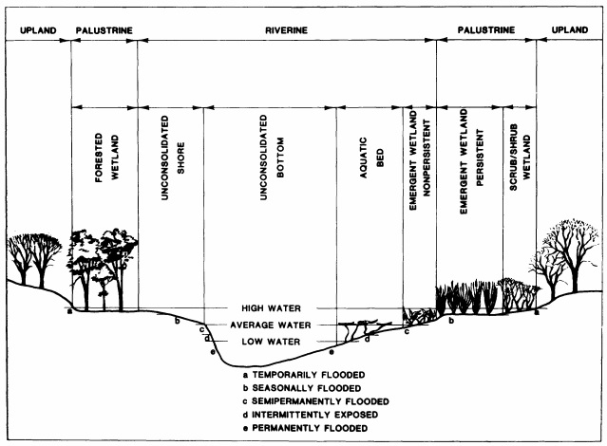
Accounting Focal Areas
Credits and Debits (Discounted-Service-Acre-Years)
Credits – Assessment of ecological value(s)
Debits – Assessment of ecological damage(s)
Vegetation Performance Standards
Trees – Data Driven Threshold Performance Attributes
Shrubs – Data Driven Threshold Performance Attributes
Herbaceous – Data Driven Threshold Performance Attributes
Substrate – Data Driven Threshold Performance Attributes
Notes:
Lesson descriptions should be brief.

Slide 4
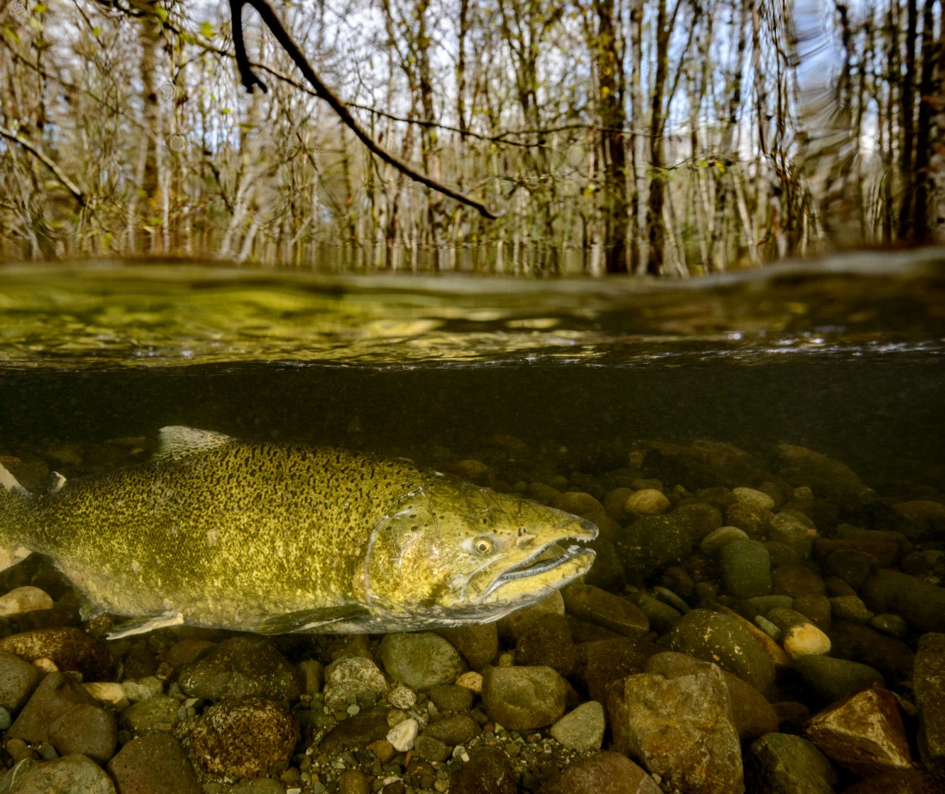
Habitat Equivalency Analysis (HEA)
Portland Harbor Superfund HEA Site
Portland Harbor Superfund HEA Facts
Developed by National Marine Fisheries Service to address recovery of estuarine habitats damaged by hazardous materials.
Uses habitat indicator species (e.g., Chinook salmon) to gauge functional habitat value scores (ranked by an expert panel) ranging from 0 (no value) to 1.0 (optimum value).
Applies ‘capitalization’ rates to adjust scores based on the delta values between maximum damages to full recovery (Debits) or from baseline to projected target values (Credits) over time.
Habitat values are measured in discounted-service-acre-years (DSAYs aka credits and debits) or value of ecosystem services of one acre of habitat for one year.
Notes:
Example objectives
At the end of this lesson, you will be able to:
Save files to the team Web server.
Move files to different locations on the team Web server.
Share files on the team Web server.

Slide 5
HEA Algorithm Variables
Habitat equivalency is a service-to-service based scaling method to calculate the amount of restoration necessary to off-set or compensate habitat damages from hazardous substances.
It is an attempt to document the total functional change over time from a damaged habitat level of function to a recovered habitat level of function.
HEA Algorithms
DSAYs - Discounted-Service-Acre-Years
A – Habitat Acres
RS – Recovered Services Value Score
DS – Damaged Services Value Score
CR – Capitalization Rate
DSAYs = (RS – DS) / CR
Total DSAYs = DSAYs x A

Slide 6
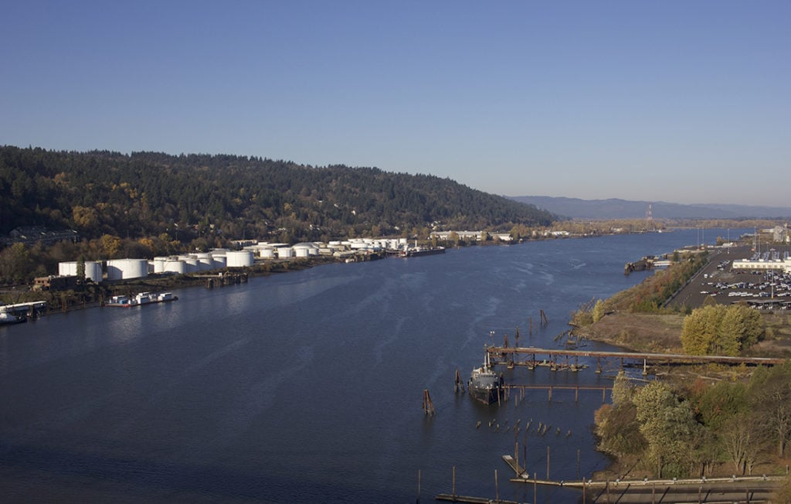

Slide 7
USFWS Habitat Suitability Index Example for Chinook Salmon

Slide 8
HEA Application Derived Primarily from Mitigation Bank Instrument and Prospectus
Proposed | Habitat | Pre-construction Condition | Acres | Existing Functional Value | Proposed Functional Value | Delta Value | HEA DISCOUNT Rate ** | DSAYs/Ac | DSAYs * Acres | DSAYs by Cowardin Class
Coward in Class | HEA Category |  | Totals |  |  |  |  |  |  | Totals
 |  | Shallow Water riprap/concrete adjacent | 3.75 | 0.1 | 1 | 0.9 | 0.032727 | 27.5 | 103.1
Riverine | Shallow Water | Shallow Water covered | 0.22 | 0.5 | 1 | 0.5 | 0.032727 | 15.3 | 3.4
 |  | Shallow Water Gravel/rock, degraded | 0.84 | 0.5 | 1 | 0.5 | 0.032727 | 15.3 | 12.8
 |  | ACM piles | 0.56 | 0.05 | 0.8 | 0.75 | 0.032727 | 22.9 | 12.8
 |  | ACM covered | 0.14 | 0.1 | 0.8 | 0.7 | 0.032727 | 21.4 | 3.0
 |  | ACM riprap | 0.38 | 0.1 | 0.8 | 0.7 | 0.032727 | 21.4 | 8.1
 | ACM | ACM unvegetated/steep | 0.41 | 0.1 | 0.8 | 0.7 | 0.032727 | 21.4 | 8.8 | 188.3
 | Unvegetated | Riparian unvegetated | 0.14 | 0 | 0.8 | 0.8 | 0.032727 | 24.4 | 3.4
 |  | Riparian invasive | 0.32 | 0.1 | 0.8 | 0.7 | 0.032727 | 21.4 | 6.8
 |  | Riparian native forested | 0.09 | 0.5 | 0.8 | 0.3 | 0.032727 | 9.2 | 0.8
 |  | Riparian invasive | 0.16 | 0.1 | 1 | 0.9 | 0.032727 | 27.5 | 4.4
 | Off-Channel | Riparian unvegetated | 0.68 | 0 | 1 | 1 | 0.032727 | 30.6 | 20.8
 |  | Riparian unvegetated | 1.12 | 0 | 1 | 1 | 0.032727 | 30.6 | 34.2
 |  | Upland unvegetated | 2.38 | 0 | 1 | 1 | 0.032727 | 30.6 | 72.7
Palustrine |  | ACM piles | 0.21 | 0.05 | 1 | 0.95 | 0.032727 | 29.0 | 6.1 | 132.3
 | ACM | ACM riprap | 0.11 | 0.1 | 1 | 0.9 | 0.032727 | 27.5 | 3.0
 | Vegetated | Riparian unvegetated | 0.08 | 0 | 1 | 1 | 0.032727 | 30.6 | 2.4
 |  | Riparian invasive vegetated | 0.5 | 0.1 | 1 | 0.9 | 0.032727 | 27.5 | 13.8
 |  | Sum Acres | 12.09 |  |  |  |  |  | Sum Credits aka DSAYs | 321
The table above is copied out of a Microsoft Excel spreadsheet created and populated using data manually copied from two
separate PDF documents (acquired only after a nearly 2-week FOIA-like request from Oregon Department of State Lands)
because neither of them contained all the columns necessary to complete the HEA DSAY calculations. Even then, the HEA
discount rate column was still missing and the 3% rate discussed in the documents was not yielding the correct DSAY values.
It had to be treated as a variable in an algebra solution to derive the discount rate used in this table. The point is, these data
should have been prepared in advance and made available for download from an easily accessible web based digital repository.

Slide 9
HEA ‘Discount Rate’ or ‘Capitalization Rate’ Reverse Calculation
Solve for x:
0.9/x = 27.5
0.9x/x = 27.5 x
0.9 = 27.5x
0.9/0.9 = 27.5x/0.9
1 = 30.5555x
1/30.5555 = 30.5555x/30.5555
1/30.5555 = x
x = 0.032727
Discount Rate (DR) vs Capitalization Rate (CR)
DR = (Future Value/Present Value)^{1/n (# years)}
Note: 1/30 years = 0.03333
CR = Annual Return/Present Value
These formulas are borrowed from economic investment and real estate valuation methods, respectively. A request for an explanation of the theory and / or logic NMFS is using to support their ‘rate’ arithmetic for application at the Portland Harbor Superfund mitigation banks has been forwarded to the Trustee Council. The DSAYs formula (delta HEA/discount
rate) resembles a CR but delta HEA is not an annual return.

Slide 10
Functional Assessment Accuracy Confidence Tests
Are ecosystem processes that support functions directly measured?
Are the methods used to rank and score criteria used to assess habitat functions field tested at multiple statistically representative reference sites in the Area of Concern, peer reviewed, and field calibrated?
Are functional scores defensible finely calibrated absolute values or are they more representative of an ordinal range of coarse values relative to one another.
No. Surrogate performance standards are used to indicate a likely trajectory to functional equivalency.
No. A panel of experts relying on a combination of best professional judgement and scientific literature reviews assigned the functional scores.
No and Yes. These scores are not defensible absolute values but are instead a coarse ordinal ranking of values.

Slide 11
Important Side Note:
What Do the No Answers Mean?
Confidence that HEA measures of ecosystem service functions are accurate is considerably compromised.
If HEA measures of ecosystem service functions alone are used to determine the measure of habitat mitigation functional equivalency, confidence that equivalency outcomes are reached is significantly lowered.
Ergo the precautionary principle dictates that no less than a 1:1 acreage ratio act as a minimum constraint on all Portland Harbor mitigation bank credit / debit exchange transactions.
These arguments should not be interpreted as an attack on the merits of the HEA method. HEA is part of a large family of environmental functional models that use performance standard surro-gates to infer measures of function. Likewise, it is an accepted practice among natural resource managers to use Delphi methods for assigning functional scores to fish and wildlife habitat. But in most, if not all, cases where these kinds of models are applied to credit and debit exchange decisions, the common consensus among natural resource managers and regulators has predom-inantly been to enforce precautionary approach-es (such as minimum 1:1 acreage ratios) based on the commonly recognized limited abilities of these models to directly and accurately measure ecosystem functions.

Slide 12
Credits: DSAYs / Acres Ratio and Debits: Acres / DSAYs Ratio
Acreage Equivalency Calculation Test
Rationale and Means for Obtaining Acreage Equivalency
Credits for 12.09 acres = 321 DSAYS
321 DSAYs / 12.09 acres = 26.550868486: 1
12.09 acres x 26.550868486 = 321 DSAYS
5.0 acres x 26.550868486 = 132.75434243 DSAYs
Debits for 12.09 acres = 321 DSAYS
5.0 acres x 26.550868486 = 132.75434243 DSAYs
132.75434 DSAYs (Credit) – 132.75434 DSAYs (Debit) = 0
A zero result means a 1:1 acreage replacement ratio
A positive result means < 1:1 acreage replacement ratio
A negative result means > 1:1 acreage replacement ratio
Note: A convention on the number of decimals credit and debit values are carried to is likely warranted.
A minimum of 1 : 1 acreage equivalency can only be achieved if the same HEA method to assess credits (DSAYs) is also used to assess debits (DSAYs).
Acreage equivalency is important because HEA (like most habitat functional assessments) is not a direct functional analysis but rather an assessment of surrogate performance standards that resource managers use to indicate an assumed trajectory toward functional recovery.
Surrogate performance standards ARE NOT functions. The argument for functional equivalency as a means through which to negate the need for acreage equivalency should meet a series of tests that support a high level of confidence that functions are accurately measured.

Slide 13
Why Should We Use Functional Assessments at All?
They Are Good Characterization Tools
They Act as Interim Placeholders
Functional assessments help resource managers to identify and inventory key environmental attributes and relationships supporting ecosystem services.
Functional assessments allow resource managers to ordinally rank areas of high, medium, and low functions which in turn serves better informed natural resource planning and regulatory decisions.
Functional assessments provide candidate benchmark targets useful in identifying and applying monitoring performance standards and their pass / fail thresholds.
Eventually our technology will enable resource managers to directly and accurately measure the fundamental processes that support ecosystem services for targeted areas of concern in a cost efficient and timely manner. Until that day arrives, each new generation of methods that employ surrogate indicators of ecosystem functions incrementally brings us closer to our ultimate goals. It is truly a work in progress.

Slide 14
Estimated Credit/Debit Transactions at Four Operational Mitigation and Conservation Banks in the Portland Harbor
Alder Creek Linnton Mill PGE Harborton Rinearson Creek
Low Estimate
High Estimate

Slide 15
Price Per Credit
Credit prices are generally considered proprietary information by the bank sponsors although on occasion some sponsors have revealed them in their reports to their Interagency Review Teams (IRTs). These prices can be influenced by many factors including but not necessarily limited to:
Credit prices of other mitigation banks selling credits in the same service area.
Cost of producing a credit (e.g., land acquisition, site preparation, short term maintenance and long-term management), credit demand vs. supply, financial solvency of sponsors, etc.
The price range of credits (DSAYs) currently being sold in the Portland Harbor primary and secondary service areas are estimated between $75,000 and $125,000 per credit. Regarding the tally of credits for the mitigation bank represented in the previous slides, that could mean an estimated credit value between $37,657,500 and $62,762,500. A brief review of the credits available to all the mitigation banks in the Portland Harbor reveals the high end of this range could exceed 91 million dollars.
Note: These credit value estimates, if verifiable, are orders of magnitude higher than most, if not all, the other mitigation banks in Oregon with similar acreages, land acquisition values, and remedial measures. This may be relevant in discussions where Portland Harbor mitigation bank sponsors claim a particular remedial measure (such as contaminated sediment removal) is considered as ‘cost-prohibitive.’

Slide 16
Portland Harbor Mitigation Banks Service Areas

Slide 17
Exporting Ecosystem Services?
One of the long-standing arguments against mitigation banks is that they allow for the ‘export’ of ecosystem services away from the areas of impact and into the ‘relatively pristine area’ where the mitigation bank is located. Proponents of mitigation banks tend to say that the impact areas are already ‘lost causes’ because of their extensive history of degradation. Opponents of mitigation banks rifle back, what you call ‘lost causes’ are the neighborhoods where we live, work, and spend most of our lives. They also point out these are the areas most likely occupied by minorities and people of color and that these ‘exports’ should be viewed as another reflection of racial discrimination. In grass roots efforts to protect the ecological and social integrity of these neighborhoods, people have called out for ‘environmental justice’ or equal protection under environmental laws such as the National Environmental Policy Act (NEPA), the Clean Water Act (CWA), the Comprehensive Environmental Response, Compensation, and Liability Act (CERCLA or Superfund), the Endangered Species Act (ESA), etc.

Slide 18
Exporting Ecosystem Services?
Generally, the ‘export argument’ is that the damages are happening in my area and the mitigation bank is outside my area, so the ‘bad’ is happening here and ‘good’ is happening there, away from where my family, neighbors, and the resident fish and wildlife incurring the ‘bad’ can benefit from the ‘good.’ However, in the Portland Harbor area three out of the four operational mitigation banks are in the Portland Harbor area. So, in the cases where the ‘bad’ is happening inside the Portland Harbor primary service area, the good is also occurring inside the Portland Harbor. And where the bad is occurring outside of the Portland Harbor in the secondary service area, the ‘good’ is happening inside the Portland Harbor. In other words, via these mitigation banks ecosystem services are either being retained in the Portland Harbor or are being exported into the Portland Harbor, not away from it.

Slide 19
Exporting Ecosystem Services?
Now there is one mitigation bank, Rinearson Creek Bank, about 11-miles upstream and south of the southern edge of the Portland Harbor primary service area, that could conceivably be considered to receive the ‘good’ at the expense of the ‘bad’ inside Portland Harbor. But a closer look at its position along the confluence of Rinearson Creek and the Willamette River give a way to an understanding that it is very likely benefiting both juvenile and adult anadromous salmonids as they migrate toward and away from Portland Harbor. Many of these salmonids are Federally listed as threatened or endangered under the Endangered Species Act and are indeed a key focal target for protection and recovery in the Willamette Valley Ecoregion.

Slide 20
Exporting Ecosystem Services?
One possible solution to the ‘ecosystem services export problem’ in the Portland Harbor Mitigation Bank Primary Service Area might be the estab-lishment of one to several multiple site mitigation bank(s). The existing inventory of potential restoration sites in the Portland Harbor might be a good place to start looking for candidate collective mitigation bank site oppor-tunities. The argument for using these sites in the context of a mitigation bank over individual site-specific mitigation is that mitigation banks have a much better track record for enforced regulatory oversight and efficacious long-term stewardship than individual mitigation actions.
Note: This does not mean case-by-case site specific mitigation actions are never an appropriate solution. Both approaches in combination may best facilitate a route where migratory juvenile salmon in the Portland Harbor have adequate feeding, resting, and predator avoidance opportunities all along their trek through the Portland Harbor into the confluence of the Willamette and Columbia Rivers.

Slide 21
Multiple Site Mitigation Banks
There is a precedent in Oregon for one mitigation bank sponsor to
manage multiple geographically separate mitigation bank sites.
Note: The West Eugene Bank model should only be considered here for the multiple site
concept. Implementation opportunities and constraints in West Eugene are much different than those in the Portland Harbor Superfund Area of Interest.

Slide 22
Exporting Ecosystem Services?
The problems in the Portland Harbor are complex and their solutions promise to be equally if not more complex. The question should not be whether it is appropriate to have mitigation banks in and / or near the Portland Harbor. Rather, when is it appropriate to use a given mitigation bank as part of a given solution and when is it not appropriate to use one? We should strive to select the right tool for the right job, sometimes a mitigation bank will be involved and sometimes it will not. The overarching goal should be intelligent tool selection and application based on the best available science and stakeholder input.

Slide 23
Tracking Credit and Debit Transactions
RIBITS Comment: “The total number of credits released by the trustees on 11/2/2020 was 11.97. This ledger represents this release of 11.97 credits as 2 releases of 10.12 and 10.14 for a total of 20.26 with a reallocation of 8.29 credits ((10.12+10.14) - 8.29 = 11.97). This ledger accounting was done to shift 8.29 credits from the NRD only category, to potential ‘dual purpose’ credits.”
Note: It is not possible in this ledger to track which account
the 8.29 credits were transferred to. Nor is it possible to
view the acres associated with each debit withdrawal or
the spatial coordinates indicating where the debited impact
areas are located. Imagine walking into a bank and asking the
bank teller to show you where your checking account is. Then
the bank teller replies: “Well sir/miss, we cannot show you
where your checking account is, the amount of any charges
against your account, or where they came from, or what is
remaining in your account, but we can easily show you the place
where the deposits made into your account are not at!” Add to the
scenario above the fact the dollar value of 8.29 credits in the
Portland Harbor ranges somewhere in the vicinity of ½ to
1 million dollars.

Slide 24
Potential Supplemental USACOE Regulatory In-lieu-Fee and Bank Information Tracking System (RIBITS) Credit and Debit Transaction Ledger
Credit / DSAY Type | DSAYs | Acres | DSAY Debits / Acre Impact
CERCLA-NRDA/CWA Riverine | 224.39 | 12.42716304 | 18.05641394
CERCLA-NRDA/CWA Palustrine | 137.5 | 7.615022587 | 18.05641394
CERCLA-NRDA | 40.27 | 2.23 | 18.05641394
CWA | 0.00 | 0.00 | 18.05641394
Total Authorized Remaining | 402.16 | 22.27 | 18.05641394
Total Released Remaining | 152.15 | 8.43 | 18.05641394
Total Released | 252.50 | 13.98 | 18.05641394
Total Authorized | 502.51 | 27.83 | 18.05641394
LOGICAL GENERAL ORGANIZATION OF TRACKING DEBITS TO CREDITS (DSAYs) BASED ON RIBITS LEDGER
8.29 | Reallocation to Dual Purpose Credits |  | CERCLA-NRDA/CWA- Riverine | 216.1 + 8.29 = 224.39
 |  |  | CERCLA-NRDA/CWA- Palustrine | 137.5
100.35 | Withdrawals |  | CERCLA-NRDA | 148.91 - 8.29 = 140.62 – 100.35 = 40.27
The table RIBITS currently uses to display the reallocation of 8.29 Credits is difficult to interpret and could be supplemented with other tables (see example on left) to make the transaction easier to understand and follow. While the recent notes modification to the transaction’s record was helpful, it is still unclear which of the ‘dual purpose’ accounts the credits were transferred to.
It also raises the question, why were such a specific number of credits reallocated when the EPA has yet to establish the accounting methods for the non-CERCLA natural resource damage assessment (NRDA) transactions?

Slide 25
The USACOE Regulatory In-lieu Fee and Bank Information Tracking System (RIBITS) Cyber Repositories Folders are Empty for the Portland Harbor Mitigation and Conservation Banks

Slide 26
Recommendations to EPA Data Management Team
Track credit and debit transactions in the EPA relational database management system (RDBMS) independent from the tracking in the COE Regulatory In-lieu-fee and Bank Information Tracking System (RIBITS).
1
Add and populate a unique identifier field for each record of credit and debit transaction updated into the EPA RDBMS.
2
Add and populate a credit release field and a credit withdrawal field for each record of credit and debit transaction updated into the EPA RDBMS.
3
Add and populate an acre field for each record of credit and debit transaction updated into the EPA RDBMS.
4
Add and populate a date field for each record of credit and debit transaction updated into the EPA RDBMS.
5
Add and populate a latitude field and a longitude field for each record of credit and debit transaction updated into the EPA RDBMS.
6
TransactionID | Entries and | Acres | Date | Single-Purpose Credits | Dual Purpose Credits | Dual Purpose Credits | Running Total | Running Total | Latitude | Longitude
PermitNo | Withdrawals |  |  | CERCLA | CERCLA / CWA (R) | CERCLA / CWA (P) | Credits | Acres
106944 | 502.51 | 27.83 | 4/25/2019 | 140.62 | 224.39 | 137.5 | 502.51 | 27.83 | 45.597315 | -122.782438
 | -100.35 | -5.56 | 10/20/2021 | 48.56 | 224.39 | 137.5 | 402.16 | 22.27 | XX.XXXXXX | -XXX.XXXXXX

Slide 27
Recommendations to EPA Data Management Team
Recommendations
Sample Web Page
Develop a web page with a graphical user interface (GUI) connected to the Portland Harbor Superfund mitigation and conservation bank credit / debit transaction portions of the EPA RDBMS.
Develop an enterprise file geodatabase to enter, analyze, query, and report the Portland Harbor Superfund mitigation and conservation bank credit / debit transaction portions of the EPA RDBMS, host it in ArcGIS OnLine and hyperlink it to the above web page GUI recommended above.
Designate the Portland Harbor Trustee Council (or another responsible designee) as the curator of the web page and to share EPA RDBMS create, read, update, delete (CRUD) EPA RDBMS and EPA Enterprise Geodatabase duties with EPA.
Ensure CRUD responsible parties perform their duties at least once a week and that options are provided for Portland Harbor Superfund cleanup stakeholders to view and comment on any of the routine CRUD outcomes.

Slide 28
Vegetation Field Monitoring Protocols and Performance Standards
Trees – Stem Density / Percent Cover / Moisture Index / Weed Index / Height Index
Shrubs – Stem Density / Percent Cover / Moisture Index / Weed Index / Height Index
Herbaceous – Percent Cover / Moisture Index / Weed Index / Height Index
Substrate – Percent Cover

Slide 29
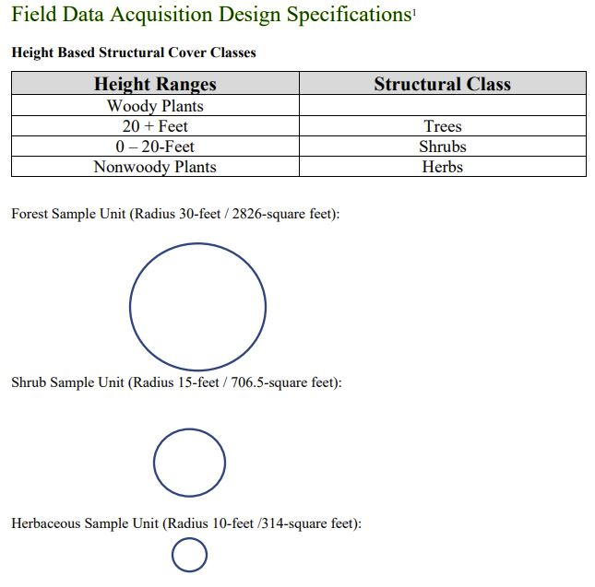
Vegetation Sampling Strategy
Delineate Homogeneous Vegetation Sample Units
Determine Sample Number
Systematic Stratified Random Sampling
Select Random Point to Begin Transect Inside Sample Unit
Select Random Bearing of Transect
Select Random Distance to Start Point on Transect
Sample at Fixed Intervals From Start Point Along Transect
Sample Nested Plots For:
Trees
Shrubs
Herbaceous
https://www.mitigationcreditdebit.com/VegRandomSampCalc.html

Slide 30
Stratified Random Sample Plots in Homogeneous Vegetation Sample or Management Units

Slide 31
Reference Site Riparian Vegetation Matching Hydrogeomorphic Targets and Appropriate Successional Sere
General rules for planting vegetation on disturbed mitigation sites:
Make sure the site is clear of contaminated substances.
Select reference sites to inventory for compiling a candidate plant species list for the target mitigation site.
If possible, use a site near the mitigation site – Tobler’s first law of geography: “Everything is related to everything else but near things are more related than distant things”.
Select reference sites with the same hydrogeomorphic (water to landform relationship) as that TARGETED at the mitigation site.
Select reference site in an early successional sere in order to ensure species chosen are capable of colonizing disturbed site conditions and tolerating direct sunlight.
Plant species in their appropriate elevation zones in relation to their hydrologic regime.
Following these guidelines will help foster a self-sustaining plant community and minimize the need for annual maintenance. However, long term monitoring and interim management interventions will likely always be necessary.
Note: This is far from a comprehensive list (e.g., site preparation, plant
selection (ecotypes), seed vs cuttings, storage and transport of plant
materials, planting season(s), potential need for herbivory guards, etc.).

Slide 32
Tree Stem Density Calculation
Genus | Species | SP1 | SP2 | SP3 | SP4
Acer | macrophyllum | 3 | 4 | 6 | 0
Pseudotsuga | menziesii | 4 | 3 | 4 | 0
Abies | grandis | 2 | 4 | 3 | 0
Populus | balsamifera | 0 | 0 | 0 | 9
Total | 33 | 9 | 11 | 13 | 9
Mean | 42 / 4 | 10.50
Acre/Sample Plot | 2826 / 43560 | 0.064876
Transect 1 Mean Stems / Acre | 10.5 / .064876 | 161
Transect 2 Mean Stems / Acre | 16.5 / .064876 | 254
Sample Unit Mean Stems / Acre | (161 + 254) / 2 | 207.5
Tree Sample Plot (2826 sq. ft.) 1
ABGR
PSME
ACMA
PSME
ABGR
PSME
PSME
ACMA
ACMA

Slide 33
Tree Vegetation Performance Standard Stem Density
Sum number of live tree stems in each sample plot.
Add the number of stems in each sample plot and divide by the total the number of plots to find the mean number of stems / plot for the transect.
Divide the square feet area of the sample plot (~ 304 sq. ft.) by the square feet in one acre (43560 sq. ft.) to derive the percent of an acre represented by the sample plot.
Divide the mean number of stems derived in step 2 by the sample plot percentage derived in step 3 to derive an estimate of mean stems per acre for the transect.
Note: Generally, it is recommended that tree and shrub stem density metrics at least initially be calculated independently. They can then be aggregated in a later series of steps if necessary.
Linnton Mill Mitigation Bank | Vegetation Performance Data - Forested Zone |  |  |  |  |  |  |  | Trees and Shrubs - Stem Counts
Tree |  |  |  |  |  |  |  |  |  |  | Sample Plots
Common | Latin | 1 | 2 | 3 | 4 | 5 | 6 | 7 | 8 | 9 | 10 | 11
Big leaf maple | Acer macrophylum | 1 |  |  |  |  |  | 1
Bitter cherry | Prunus emarginata |  |  |  |  |  |  | 1
Black cottonwood | Populus balsamifera spp trichocarpa |  |  | 1 |  |  |  | 1 |  |  |  | 2
Black hawthorn | Crataegus douglassii | 11 |  | 1 | 9
Blue elderberry | Sambucus caerulaea | 4
Cascara | Frangula purshiana |  |  | 1
Choke cherry | Prunus virginiana |  |  |  |  | 1 |  | 5 |  |  |  | 1
Columbia willow | Salix fluviatilis |  |  |  |  |  |  |  |  |  | 1
Crab apple | Malus fusca
Douglas-fir | Psuedotsuga menziessii
Douglas spirea | Spirea douglassii |  |  |  |  |  | 4 |  |  | 3 | 6
Grand fir | Abies grandis
Oregon ash | Fraxinus latifolia |  |  |  |  |  |  |  | 2 | 22 |  | 3
Oregon white oak | Quercus garryana |  |  |  |  |  | 1
Ponderosa pine | Pinus ponerosa |  |  |  |  | 2 | 7
Western red-cedar | Thuja plicata |  |  | 2 |  | 1
 | Total Number of Stems | 27
 | Mean Stems per Sample Plot | 17.16
Tree / Shrub | Acres per Sample Plot | 0.019407612
Statistics | Estimated Stems per Acre | 884.00
 | Weed Index
 | Moisture Index
Stem Density
> 1600 / acre
1200 to 1600 / acre
< 1200 / acre

Slide 34
Tree Percent Cover Calculation
Sum the total tree species percent covers for all the sample plots on the transect and divide by the number of sample plots to calculate their mean percent cover in the transect.
If there is only one transect infer the percent tree cover determined above to the entire sample unit. Otherwise, add up each transect’s mean percent cover and divide by the number of transects to determine the mean percent cover for trees in the sample unit.
Note: If there are focal species (e.g., invasive nonnative species, native species, rare species, etc.) the same procedure can be applied to each tree species or focal group independently. It is not uncommon to see calculations of the percent cover of all layers in a sample plot in an aggregate metric. Percent cover metrics are sometimes relativized for performance evaluations (e.g., 35% cover natives, 15% cover nonnative invasives, 50% cover nonnative noninvasives).
Tree Sample Plot (2826 sq. ft.)
ABGR
ACMA
ABGR
PSME
PSME
ACMA
ACMA

Slide 35
Shrub Stem Density Calculation
Genus | Species | SP1 | SP2 | SP3 | SP4
Salix | lucida | 9 | 2 | 1 | 2
Salix | scouleriana | 0 | 1 | 5 | 6
Spirea | douglassii | 0 | 8 | 2 | 1
Fraxinus | latifolia | 1 | 0 | 1 | 0
Cornus | sericea | 0 | 1 | 1 | 1
Total | 46 | 10 | 12 | 10 | 14
Mean | 46 / 4 | 11.5
Acres/Sample Plot | 706.5 / 43560 | 0.016219
Transect 1 Stems/Acre | 11.5 / 0.016219 | 709
Transect 2 Stems/Acre | 15.0 / 0.016219 | 925
Stems / Sample Unit | (709 + 925) / 2 | 817
Shrub Sample Plot (706.5 sq. ft.) 1
SALU
SALU
SALU
SALU
SALU
SALU
FRLA
SALU
SASC
SALU

Slide 36
Shrub Vegetation Performance Standard Stem Density
Sum number of live shrub stems in each sample plot.
Add the number of stems in each sample plot and divide by the total the number of plots to find the mean number of stems / plot for the transect.
Divide the square feet area of the sample plot (~ 304 sq. ft.) by the square feet in one acre (43560 sq. ft.) to derive the percent of an acre represented by the sample plot.
Divide the mean number of stems derived in step 2 by the sample plot percentage derived in step 3 to derive an estimate of mean stems per acre for the transect.
Linnton Mill Mitigation Bank | Vegetation Performance Data - Scrub-shrub Zone
Scrub-shrub
Common | Latin | 1 | 2 | 3 | 4 | 5 | 6 | 7
Red osier dogwood | Cornus sericea |  |  |  | 1 |  | 1 | 1
Pacific willow | Salix lucida var lasiandra |  | 9 | 2 | 1 | 2 | 19 | 22
Douglas spirea | Spirea douglassii |  |  | 8 |  | 2 |  | 1
Oregon ash | Fraxinus latifolia |  |  |  |  |  |  | 1
Scouler's willow | Salix scouleriana |  |  | 1 |  |  | 3
 | Total Number of Stems | 0 | 9 | 11 | 2 | 4 | 23 | 25
 | Mean Stems per Sample Plot | 10.56
 | Acres per Sample Plot | 0.006986741
Shrub | Estimated Stems per Acre | 1511.79
Statistics | Weed Index
 | Moisture Index
Stem Density
> 1600 / acre
1200 to 1600 / acre
< 1200 / acre

Slide 37
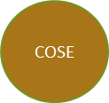
Shrub Percent Cover Calculation
Sum the total shrub species percent covers for all the sample plots on the transect and divide by the number of sample plots to calculate their mean percent cover in the transect.
If there is only one transect infer the percent tree cover determined above to the entire sample unit. Otherwise, add up each transect’s mean percent cover and divide by the number of transects to determine the mean percent cover for trees in the sample unit.
Note: If there are focal species (e.g., invasive nonnative species, native species, rare species, etc.) the same procedure can be applied to each shrub species or focal group independently. It is not uncommon to see calculations of the percent cover of all layers in a sample plot in an aggregate metric. Percent cover metrics are sometimes relativized for performance evaluations (e.g., 35% cover natives, 15% cover nonnative invasives, 50% cover nonnative non-invasives).
Shrub Sample Plot (706.5 sq. ft.)
SPDO
SPDO
SPDO
SPDO
ACMI
COSE

Slide 38
Herbaceous Percent Cover Calculation
For each herbaceous species in the sample plots along the transect in the sample unit, create a table that sums the percent covers of all the herbaceous species in each sample plot.
For each sample plot, subtract total herbaceous species percent cover from 100 to derive an estimate of percent cover of bare substrate.
Sum the total herbaceous species percent cover for each sample plot in the transect and divide by the number of sample plots to derive the mean herbaceous species percent cover for the transect.
Sum the bare substrate percent cover for each sample plot in the transect and divide by the number of sample plots to derive the mean bare substrate percent cover for the transect.
Herbaceous Sample Plot (314 sq. ft.)

Slide 39
Herbaceous Vegetation Performance Standard Attribute Definitions
Percent cover: By species, from top / down view, the area covered by herbaceous species canopy in the sample unit area.
Moisture Index: By species, numeric indicator of tolerance (1 : high tolerance to 5 : low tolerance) of low oxygen levels in the root zone due to high water levels.
Weed Index: By species, numeric indicator of the species nativity (1 : Native, 2: Nonnative, and 3: Nonnative Invasive).
Note: The high percent cover of bare ground in these samples may indicate the vegetation is not yet meeting the target percent cover objectives. The determination of need for remedial actions is contingent on other field and remote sensing observations:
Are there seasonally frequent and long periods of inundation in this sample unit?
Are the plants observed reflecting natural colonization or recent planting?
Do they receive extensive shade from a dense tree and / or shrub canopy?
Determining the circumstances contributing to the bare ground and why there is a FACU species in the same sample plot as two OBL species are both contingent on having sample plot spatial coordinates and field visit verifications during the appropriate field season(s).
Herbaceous | Sample Plots | 1 | 2 | 3 | 4 | 5 | 6
Common | Latin
Spike bentgrass | Agrostis exarata |  |  |  |  |  | 15
Columbia stickseed | Coreopsis tinctoria |  |  |  |  | 2.5 | 2.5
Water purslane | Lythrum portula |  |  |  | 2.5 | 2.5
Creeping spikerush | Eleocharis palustris |  |  |  |  | 2.5
 | Total Percent Cover | 0 | 0 | 0 | 2.5 | 7.5 | 17.5
 | Estimated Percent Bare Ground | 100 | 100 | 100 | 97.5 | 92.5 | 82.5
Herbaceous | Estimated Mean Percent Cover | 8.75
Statistics | Estimated Mean Percent Bare Ground | 91.25
 | Weed Index | 5.00 | 5.00 | 5.00 | 5.00 | 2.33 | 1.00
 | Moisture Index | 1.00 | 1.00 | 1.00 | 1.00 | 2.00 | 2.29
Why is there a FACU species
In the same sample plot as two
OBL species?
Extrapolated from Sample Plot 4
Moisture Index | Weed Index
1 to 3 | 1 to 3
3 to 4 | 3 to 4
4 to 5 | 4 to 5
Note: The red highlighted areas with arrows asking questions are placed here to illustrate what a IRT member thinks about when preparing for a field visit to verify mitigation bank performance standard monitoring reports before deciding whether to recommend credit releases.

Slide 40
Vegetation Manager Database

Slide 41
Moisture Index (Mindex) Weed Index (Windex)
Obligate (OBL) = 1.0
Facultative-wet (FACW) = 2.0
Facultative (FAC) = 3.0
Facultative upland (FACU) = 4.0)
Upland (U) = 5.0
Native species = 1.0
Nonnative species = 3.0
Nonnative Invasive = 5.0
Species | Mindex | % Cover | Weight % Cover
ALGE | 1 | 5 | 5
DECE | 2 | 63 | 126
MEPU | 1 | 63 | 63
Total |  | 131 | 194
SMind | 1.5
Species | Windex | % Cover | Weight % Cover
ALGE | 1 | 5 | 5
DECE | 1 | 63 | 63
MEPU | 5 | 63 | 315
Total |  | 131 | 383
SWind | 2.9

Slide 42
Excel Spreadsheet Reports From Vegetation Manager Database – SQL Query
SELECT [SamplePlot].SPlotNo, Sum([SamplePlot].PCover) AS PctCoverTotal, Sum([PCover]*[MIndex]) AS MIndexTotal, Sum([PCover]*[WIndex]) AS WIndexTotal, ([MoistureIndexTotal]/[PCoverTotal]) AS Mindex, ([WeedIndTotal]/[PCoverTotal]) AS Windex, [SamplePlot].Latitude, [SamplePlot].Longitude
FROM SamplePlot
GROUP BY [SamplePlot].SPlotNo,[SamplePlot].Latitude, [SamplePlot].Longitude

Slide 43
Discovery Park Moisture and Weed Index Predictive Surfaces
Predictive surfaces were created using ArcGIS Spatial Analyst inverse distance weighted technique run with
Discovery Park sample plot geographically referenced moisture indexes and weed indexes, respectively.

Slide 44
Multi-Layer Vegetation Performance Calculations
A numeric structural index of vegetation can be derived by:
Independently aggregate the percent covers for each species in each layer type (e.g., tree, shrub, herbaceous) in the sample plot.
Determine the mean height class for all the species in each layer.
For each layer respectively, multiply the mean percent cover by the mean height class.
Sum of all the weighted outcomes to calculate a structural importance score (stands with greater heights, species abundance and diversity, and vertical diversity will tend to achieve higher structural importance scores).
Divide each of the weighted outcomes by the sum of all the weighted outcomes to derive a structural index for each layer (tree index, shrub index, her index). This is a measure of the relative importance of each layer in the sample.
Average the results in each sample to define a mean structural score and mean importance indexes for each layer in the transect. If there is more than one transect average the results of all the transects to derive a mean importance score and mean importance indexes for the sample unit.

Slide 46
Habitat Structural Importance Indexes Compared to Use by Birds
Bird Use of Vegetation Structure
“In studies in which landscape level forest structure was found to be more predictive of bird occurrence than stand level forest structure (Saab 1999, Mitchell et al. 2001, Grand and Cushman 2003), a mismatch between extent of bird and vegetation sampling may have influenced conclusions. The role of stand-level structure in providing habitat may therefore have been underestimated. This finding has important implications for conservation planning because it means that the structural conditions (e.g., successional or stand development stage) within a forest reserve or land management unit can influence its suitability for different organisms. Regional or landscape scale conservation planning based on assessment of cover type alone, therefore, may be insufficient to capture important habitat relationships occurring at fine scales. Information at both scales, if available, is relevant and desirable.”
Katherine Manaras Smith, William S. Keeton, Therese M. Donovan, and
Brian Mitchel. 2008. Stand-Level Forest Structure and Avian Habitat:
Scale Dependencies in Predicting Occurrence in a Heterogeneous
Forest, Forest Science 54(1):36-46, DOI: 10.1093/forestscience/54.1.36.
Marshall, John. 1993. Application of Links Wildlife Habitat Importance Index Classification and Assessment at the Astoria Airport Mitigation Bank, Draft Report to: Oregon Department of State Lands, Salem, OR.

Slide 47
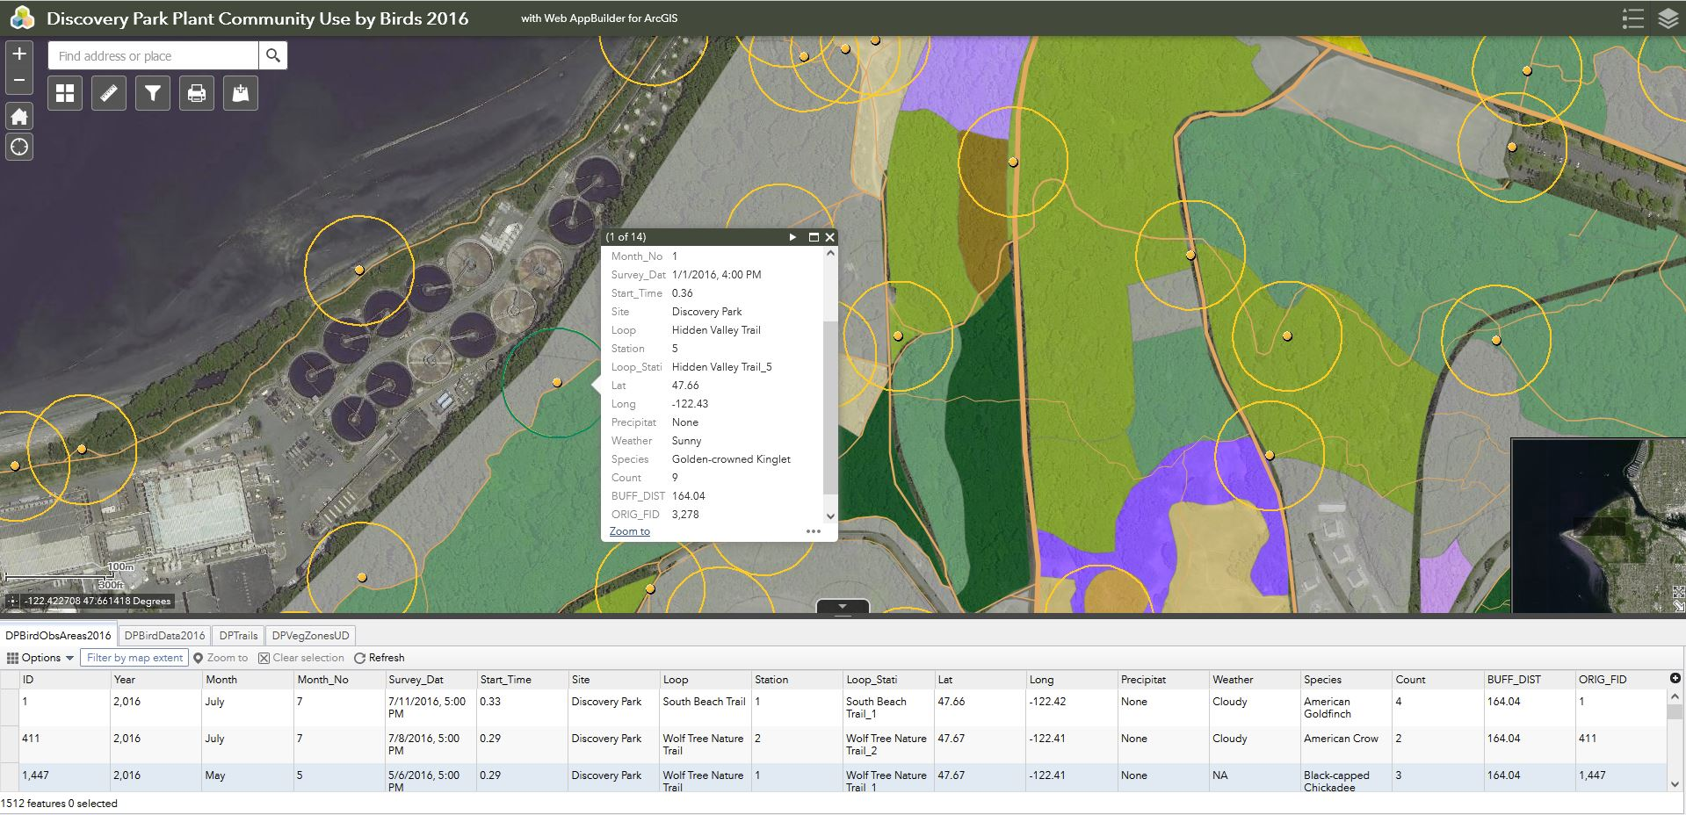
Multi-Layer Vegetation Species-Habitat Relationships
The structural conditions (e.g., successional or stand development stage) within a forest management unit can influence its suitability for different organisms. That means that horizontal measures of cover classes and stem densities should be supplemented with vertical measures of vegetation types (e.g., trees, shrubs, herbaceous) to capture important species-habitat relationships.

Slide 48
Trustee Council - RIBITS / EPA Database Design Questions (e.g., unique identifier field, primary to foreign key one-to-many relationships, normalization to 3rd normal form, etc.)

Slide 49
Standardization
There are a wide range of field sampling protocols and database design schemas used to collect, archive, analyze, and report field data. And there is on-going wide debate among resource managers regarding which protocols are the most appropriate for application. But one thing resource managers can generally all agree upon is that standardized protocols are indeed necessary if you want to be able to compare the analytics on data collected both on-site and between sites in the area(s) of interest. The inevitable challenge is to gather the group of individuals that will be tasked with collecting and managing the data and then asking that group to define one set of standardized protocols that everyone can and will agree to follow. This is no small order but any serious effort to conduct intelligent natural resource manage-ment through data driven decision tools requires it.

Slide 50
Data Potentially Associated with Vegetation Performance
Substrate
Percent cover
Date
Coordinates: Latitude, Longitude
Substrate Surface
Organic: Peat, Muck, Thatch, Litter
Mineral: Clay, Silt, Sand, Gravel
Rock: Cobble, Continuous Surface Rock
Soil Profile
Horizon: Organic, A, B, C-Parent Material
Morphology: Texture, Structure, Matrix Hue/Value, Redox Signature, Permeability

Slide 51
Data Potentially Associated with Vegetation Performance
Hydrology
Sample Points
Ground Water:
Distance from substrate surface (piezometers, ground water wells, excavated pits, etc.)
Date
Coordinates: Latitude, Longitude
Surface Water:
Depth to substrate surface (staff gauges, direct measurement, aerial drone imagery, etc.)
Date
Coordinates: Latitude, Longitude

Slide 52
Data Potentially Associated with Vegetation Performance
Bird Counts
Site
Habitat Type: Forest, Scrub-Shrub, Herbaceous/Emergent, Open Water
Species: Genus, Species
Behavior: Breeding, Feeding, Roosting, Territorial, Flyover
Date: Year, Month, Day, Time
Sample Station
Weather: Precipitation, Cloud Cover
Count
Coordinates: Latitude, Longitude

Slide 53
Summary of Potential Issues
Trustee Council - RIBITS / EPA Cyber Repository Foundational Documents Accessibility Question
Trustee Council – EPA Export of Ecosystem Services and Environmental Justice Question
Trustee Council - RIBITS / EPA Accessibility to Existing Digital Data Question
Trustee Council - RIBITS / EPA HEA Discount Rate Logic Question
Trustee Council - RIBITS / EPA Precautionary Minimum 1:1 Acreage Compensatory Mitigation Constraints
Trustee Council - RIBITS / EPA Debit Site Acreage and Spatial Coordinate Disclosures
Trustee Council - RIBITS / EPA Ledger Credit Location Question
Trustee Council - EPA Portland Harbor Credit Values vs Affordability of Remedial Actions Question
Trustee Council - EPA Reference Sites to Determine Performance Standard Thresholds Question
Trustee Council - RIBITS / EPA Transparency on Performance Standard Evaluations Question
Trustee Council - RIBITS / EPA Database Design Questions (e.g., unique identifier field, primary to foreign key one-to-many relationships, normalization to 3rd normal form, etc.)
Trustee Council - RIBITS / EPA Conventional Wisdom on Independent Reliable and Accountable Data Stewards Question
Trustee Council - RIBITS / EPA Relational Database and Enterprise Geodatabase Accessibility and Data Download Question
Trustee Council - RIBITS / EPA Standardization of Data Collection and Reporting Protocols Question

Slide 54
Questions for the Portland Harbor Trustee Council
Can the RIBITS database Cyber Repositories for the Portland Harbor mitigation banks be required to contain the same or equivalent documents as all the other mitigation banks in Oregon?
Can the RIBITS ledger be modified to display the spatial coordinates of the debit site(s) and can a data input rule be used to make the debit site acreage field a required data entry?
Will the same HEA methods used to derive credits (DSAYs) also be used to calculate debits and thereby assure acreage replacement equivalency?
Why were 8.29 Credits specifically reallocated as ‘dual purpose’ credits in the RIBITS ledger for the Linnton Mill Mitigation Bank?
Can you please provide the spreadsheets, databases, or any other digital data repositories used to calculate the existing credits and debit withdrawals in the USACOE RIBITS database?
Can you please provide the logic/arithmetic NMFS used to derive the HEA ‘discount rate’ applied at the Portland Harbor mitigation banks?

Slide 55
Questions for the Portland Harbor Trustee Council
Where can the coordinate data for the vegetation transect starting points be acquired?
Where can the bearing data for the vegetation transect starting points be acquired?
Were vegetation sample units delineated and mapped? If so, where can this data be acquired?
Were reference sites used to determine performance standard pass / fail thresholds? If so, where can the reference site data be acquired?
How were vegetation performance standards evaluated and used in making decisions about credit releases for the mitigation banks?
Can you please provide the spreadsheets, databases, or any other digital repositories used to calculate the vegetation performance standard threshold tests?

Slide 56
Conclusions
If established and managed with proper oversight and enforced transparency, mitigation banks can be very valuable tools for natural resource recovery.
If established and managed without proper oversight and with a lack of transparency, mitigation banks can be misused and become a major impediment to natural resource recovery.

Slide 57
Questions?

